Slide 1
Windows 10 Installation
Windows 10 is commonly used as a target in cybersecurity for testing exploits, malware behavior, and vulnerability assessments due to its widespread adoption and complex architecture. It helps researchers simulate real-world attack scenarios to improve defense mechanisms.

Slide 2
Download Requirements
Windows 10 ISO File.
Here is Link to download : Windows10.iso
Version | 22H2
Download | 1149419
File Size | 5.69 GB
Create Date | October 3, 2022
Last Updated | March 24, 2025

Slide 3
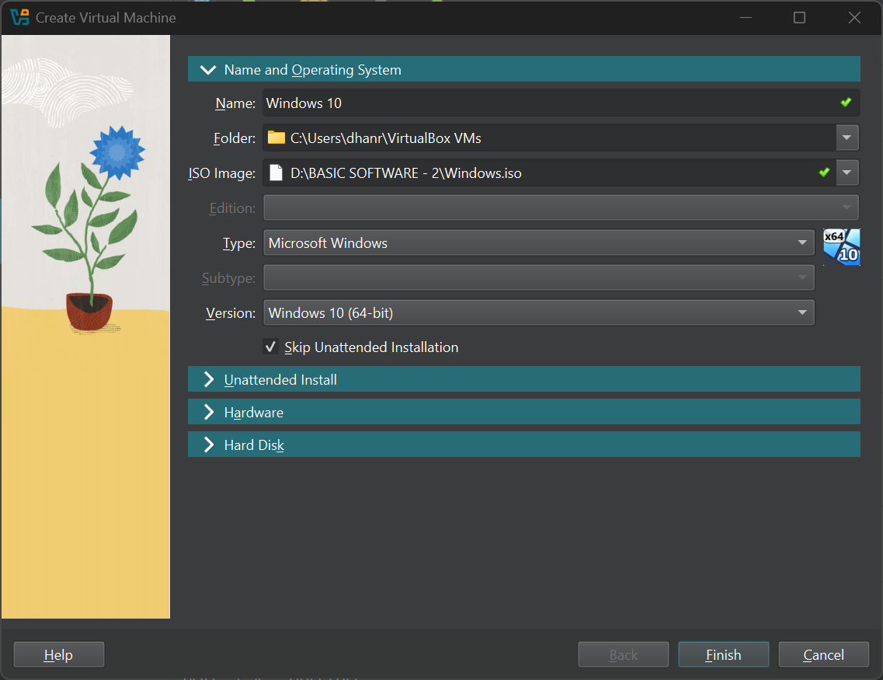
Create Virtual Machine
Click On ‘New Machine’ to Add New OS to virtual machine
Configure the ‘Name and Operating system’.
Add Name Eg. Windows10
Select the folder where you want to store the files created by Windows 10.
Select the Download ISO file.

Slide 4
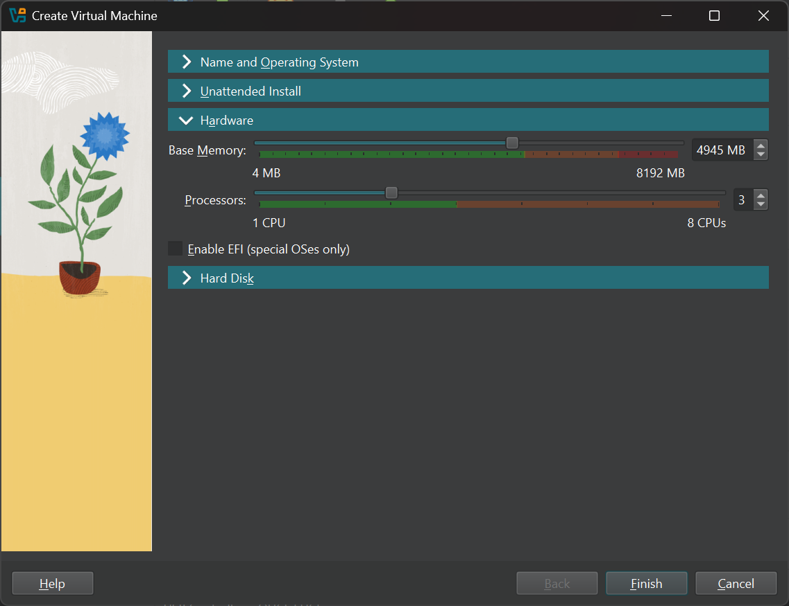
Create Virtual Machine
Hardware Configurations
Select the Base Memory (RAM) As per your Pc Compatibility.(avg 4-5 GB)
As OS Needs Processors to run any type of Program(3 CPU)

Slide 5
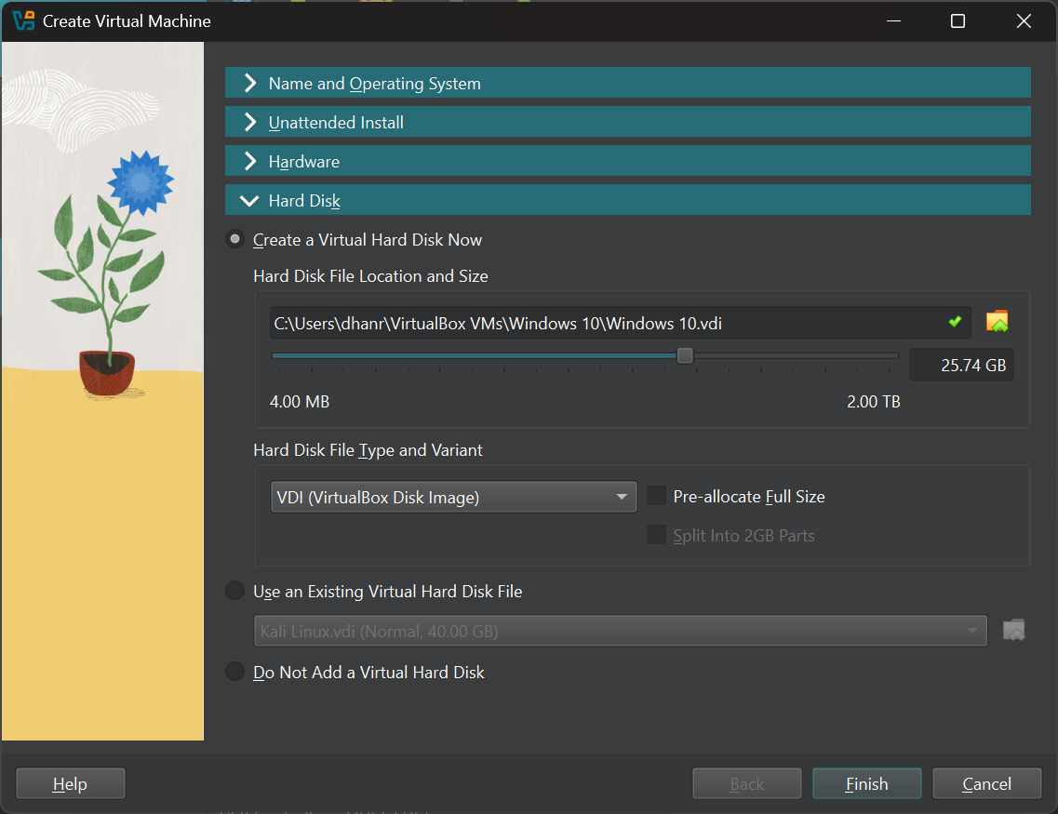
Create Virtual Machine
Hard Disk Configurations
Create a Virtual Hard disk where the Kali Linux will be get Installed.
The ideal Storage to Windows 10 Linux Is form 50Gb to up to your PC storage.
Create a virtual storage of 50Gb.
Finish the configuration, the Kali Linux will BOOT.

Slide 6
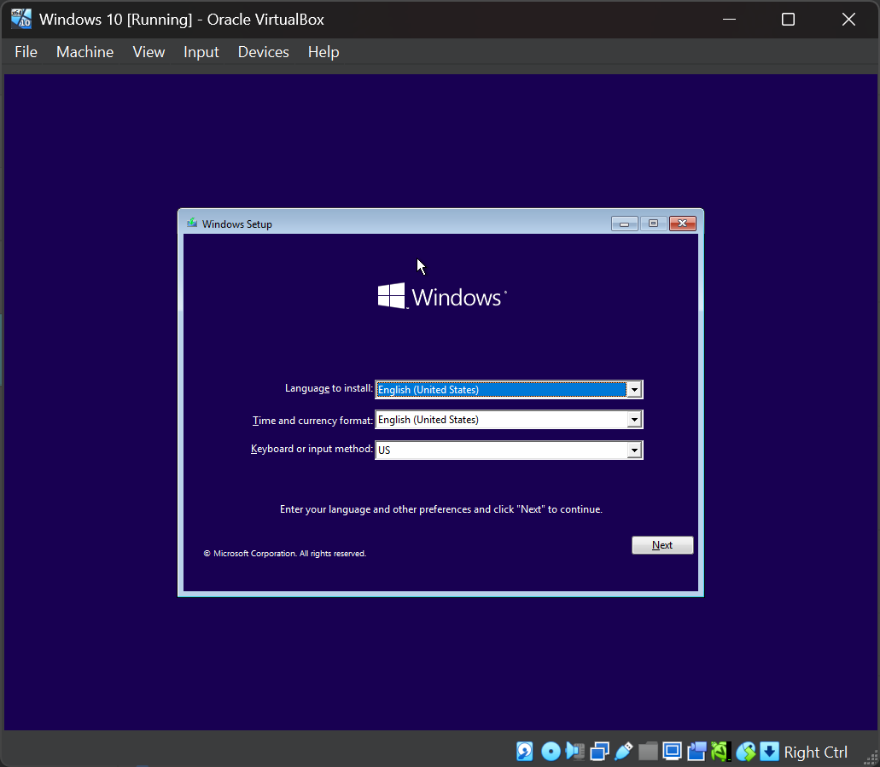
Windows 10 Configuration
Windows 10 Setup
Language to Install: English
Time and currency format: India
Keyboard : US

Slide 7
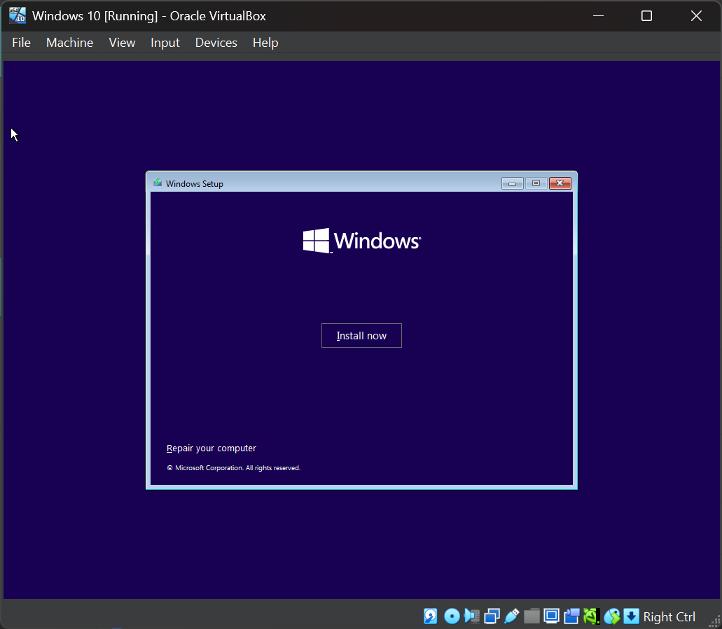
Windows 10 Configuration
Install page will displayed.
Just Click : Install Now

Slide 8
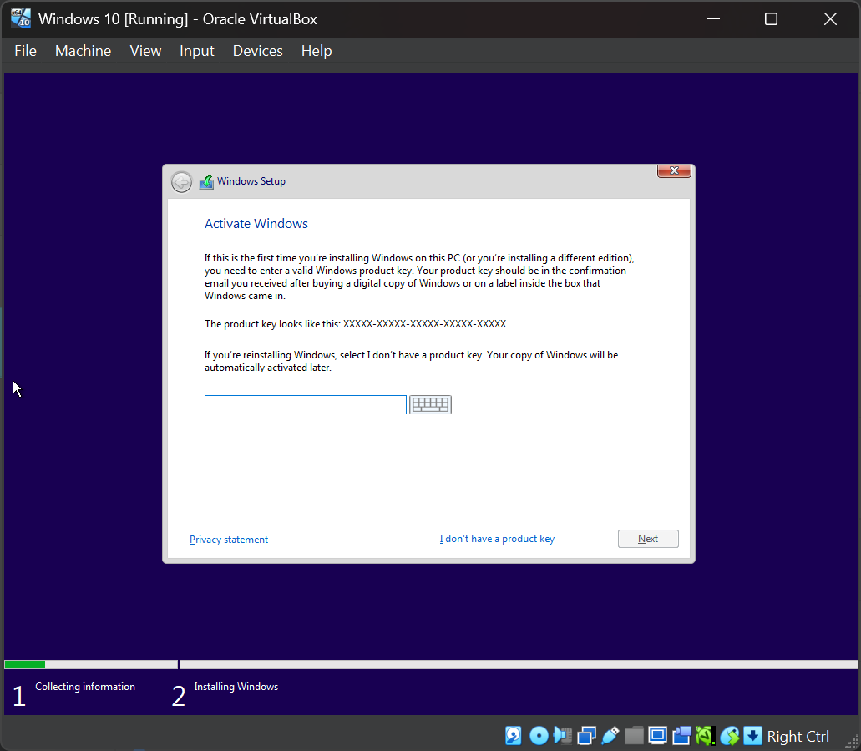
Windows 10 Configuration
Activate Windows
Enter the Lisence Key: xxxx-xxxx-xxxx-xxxx
If you don’t have product key select ‘I don’t have product key’.

Slide 9
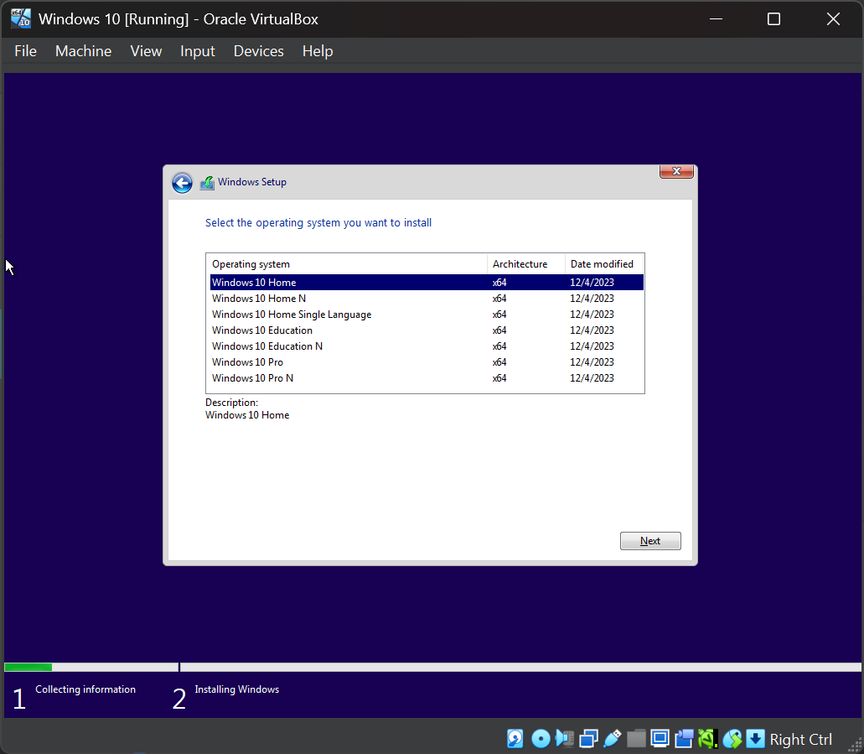
Windows 10 Configuration
Select the operating system you want to install
Select option 1 ‘windows 10 home’

Slide 10
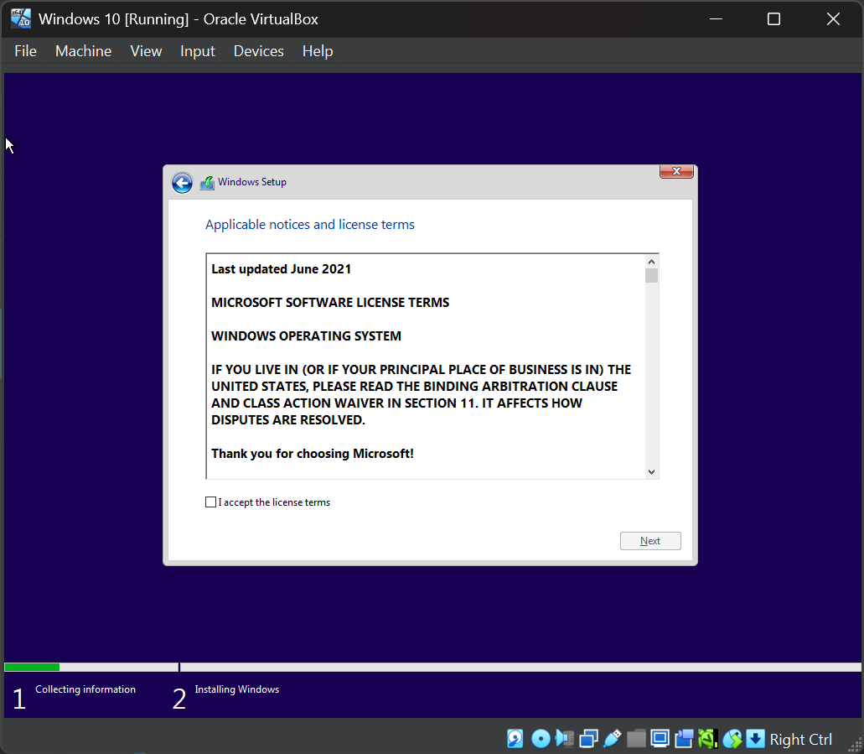
Windows 10 Configuration
Application notices and licenses terms.
Select ‘ I accept the license terms’ Read the terms

Slide 11
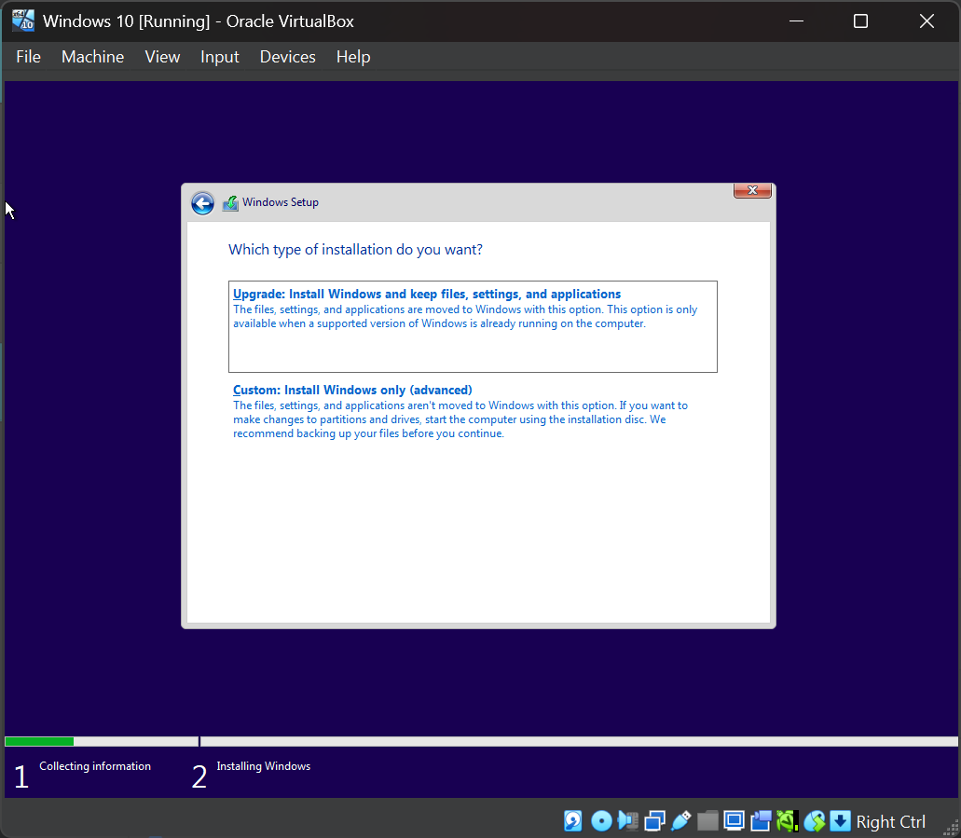
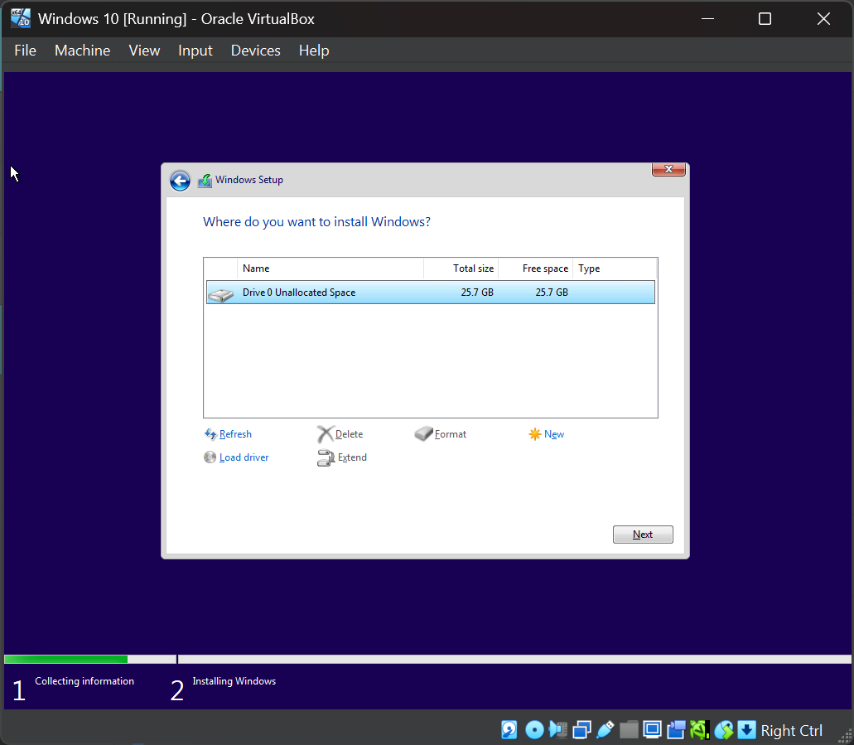
Windows 10 Configuration
Custom: install windows only.
Select the virtual storage created for Windows 10.

Slide 12
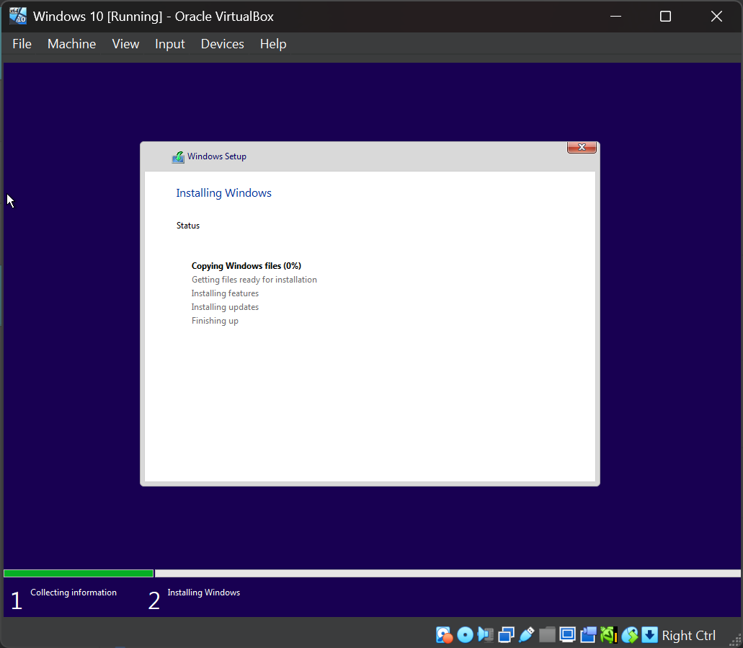
Windows 10 Configuration
Installing Windows
Status
Copying Windows files (0%)
Getting files ready for installation
Installing features
Installing updates
Finishing up

Slide 13
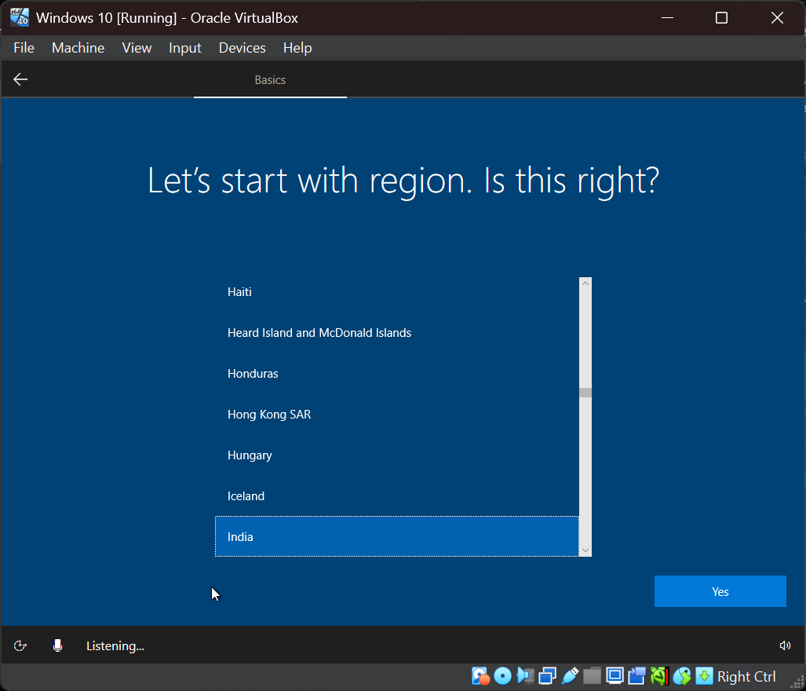
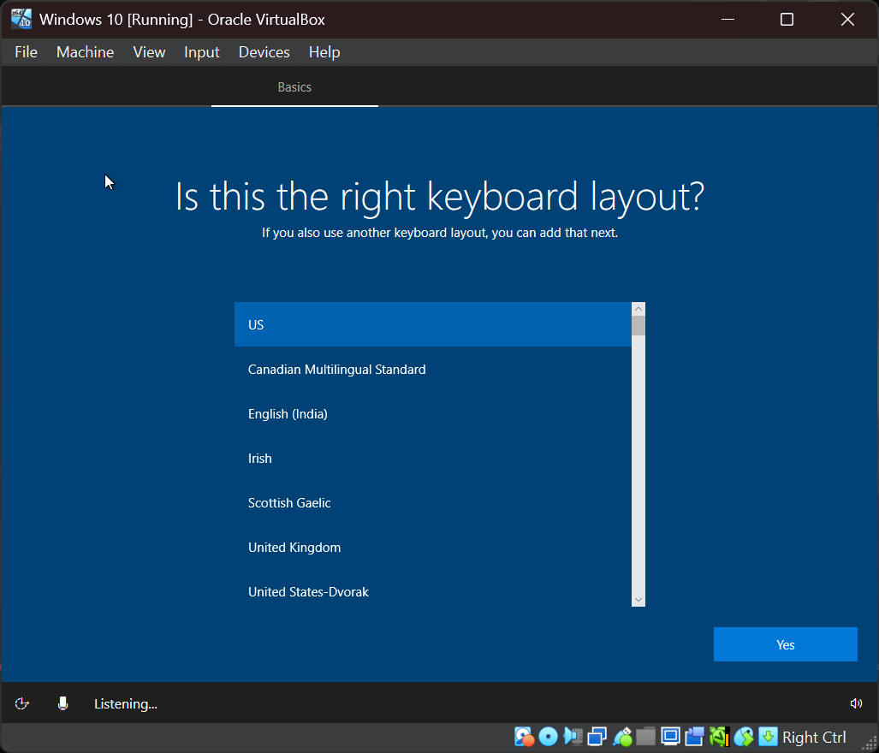
Windows 10 Configuration
Select the Region.
India
Select the Keyboard Layout: US

Slide 14
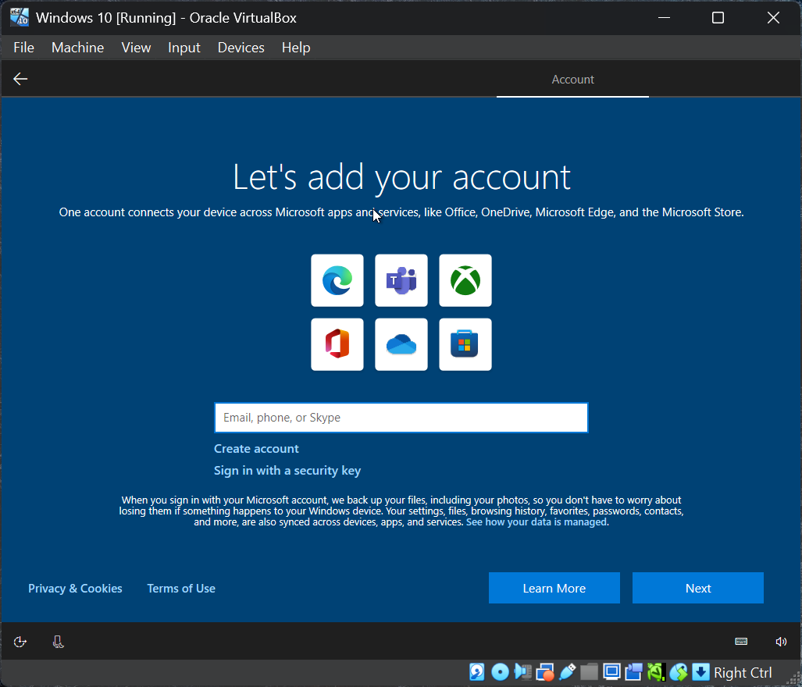
Create Virtual Machine
Add / Create your account using Email, phone, or skype
And on next page enter the Password.

Slide 15
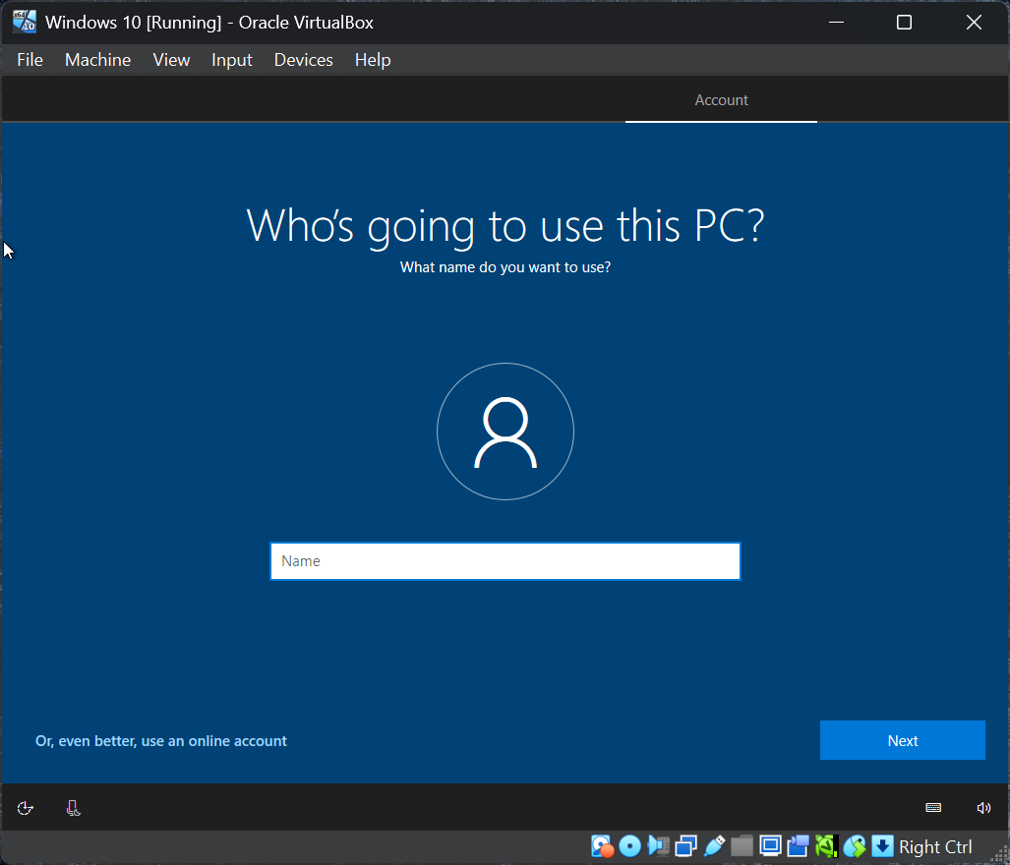
Create Virtual Machine
Add the user name:
Who’s going to use this PC?

Slide 16
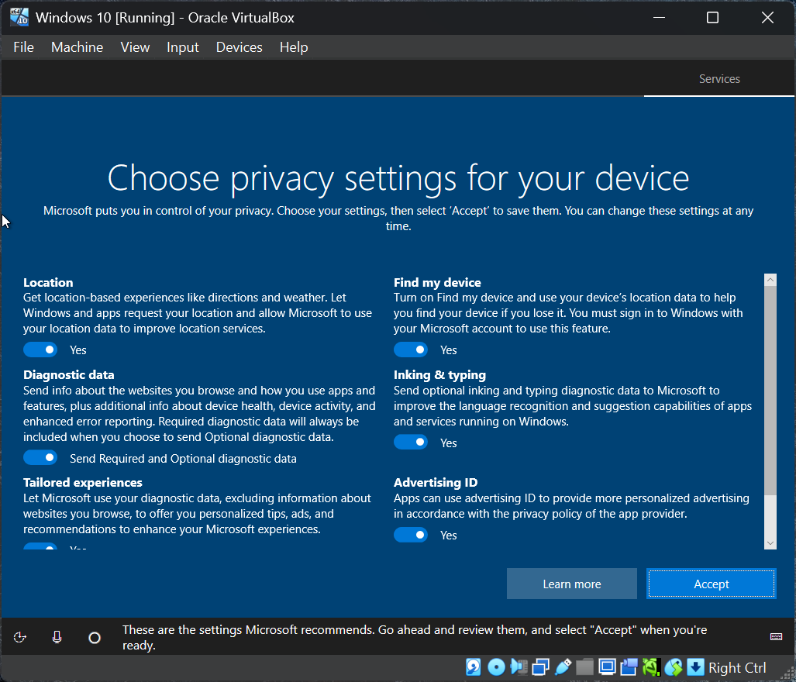
Create Virtual Machine
Choose Privacy settings for your device
Accept the policy .

Slide 17
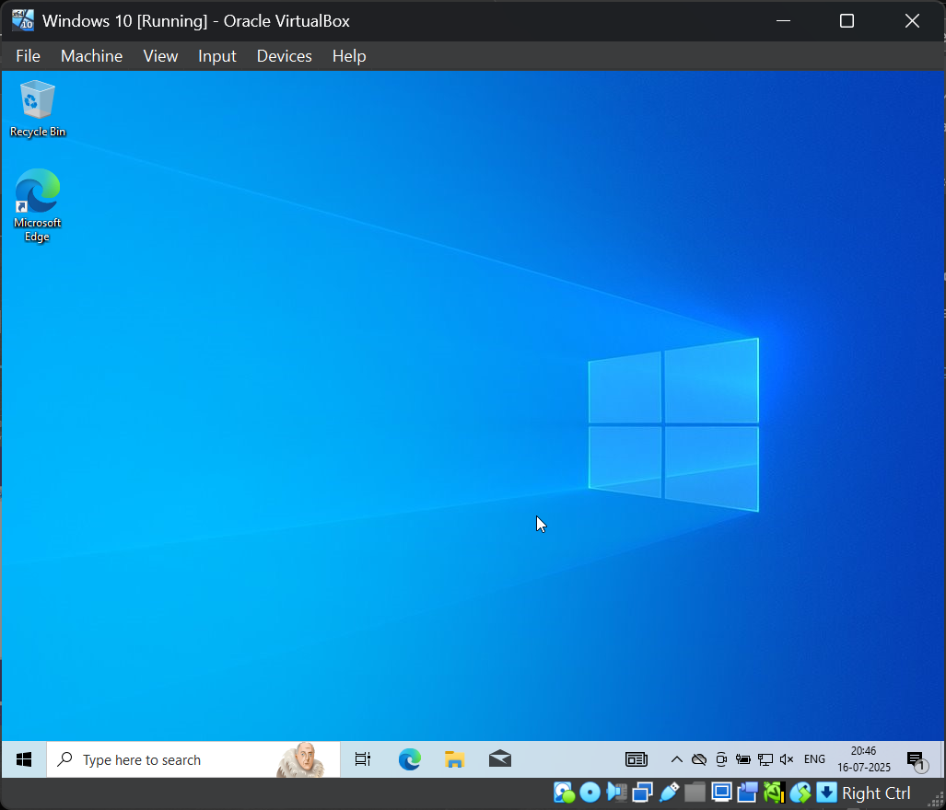
Here’s Windows 10 Disktop

